Slide 1
Azure PowerShell Automation
MTC Minneapolis – Inception POC

Slide 2
What is Automated
Storage Accounts and Containers
HDInsight
Service Bus
Event Hubs & Shared Access Policies
Azure Stream Analytics
Data Factory (Still in Preview)
Datasets, Pipelines, Linked Services

Slide 3
Script Logging
All trace events are written to a tab separated log
%TEMP%\azureserviceprovision.log

Slide 4
Provisioning Settings File
Configurable json file to change settings such as storage account names, event hub access policies, etc
Located at .\conf\azureprovisionsettings.json

Slide 5
App Settings Xml File
Contains connection strings in familiar appSettings xml format for
Storage accounts
Event Hubs
This is built during script execution

Slide 6
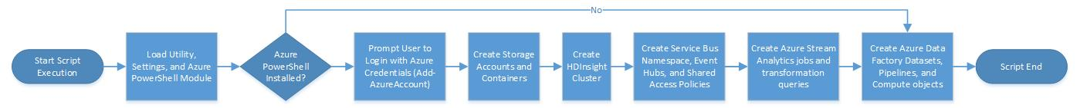
Automation Flow (High Level)

Slide 7
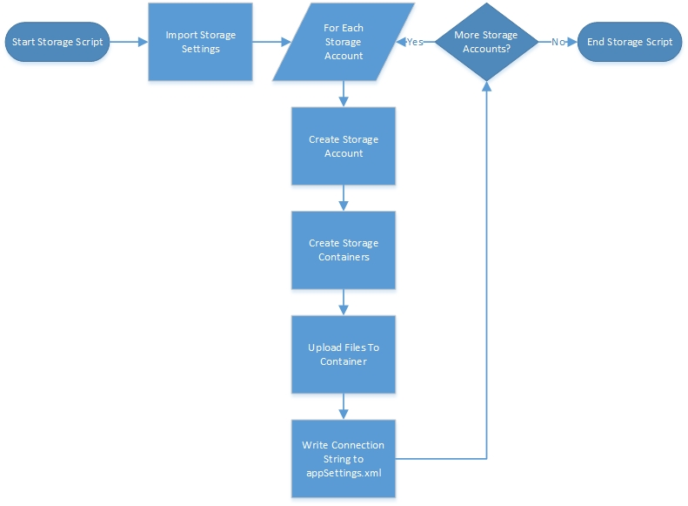
Detailed Flow - Storage

Slide 8
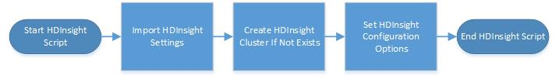
Detailed Flow - HDInsight

Slide 9
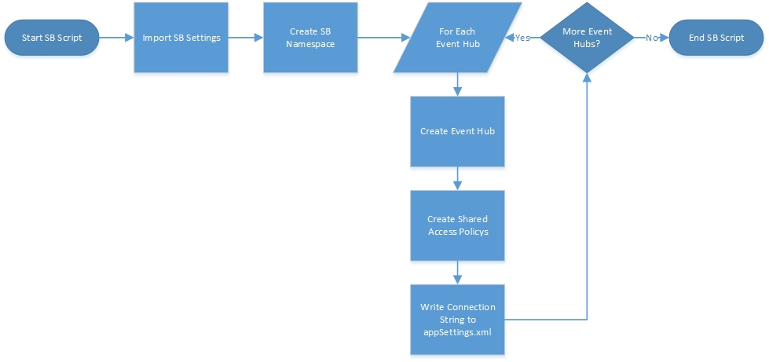
Detailed Flow - Service Bus

Slide 10
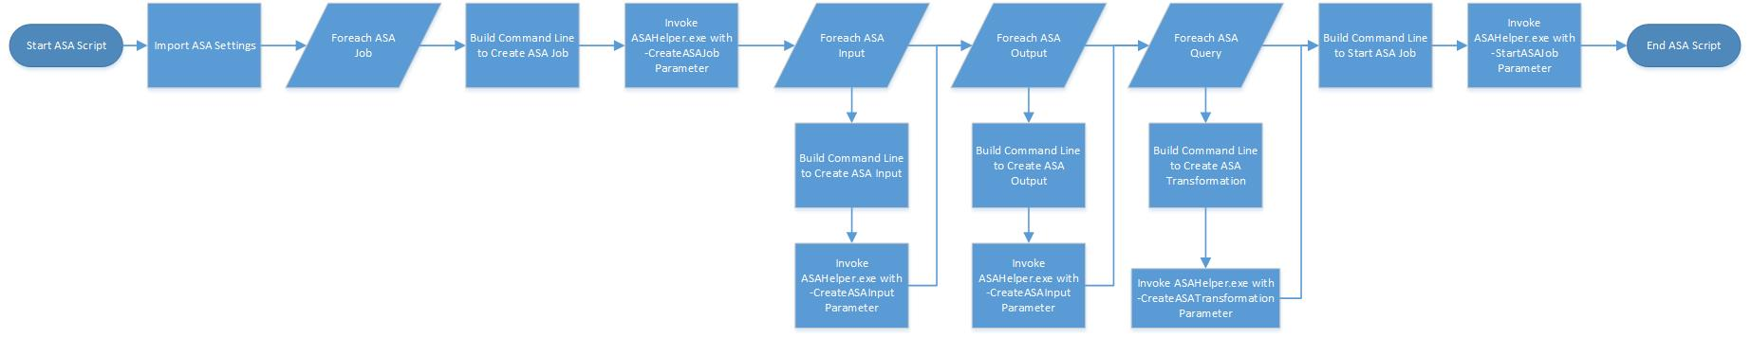
Detailed Flow – Stream Analytics

Slide 11
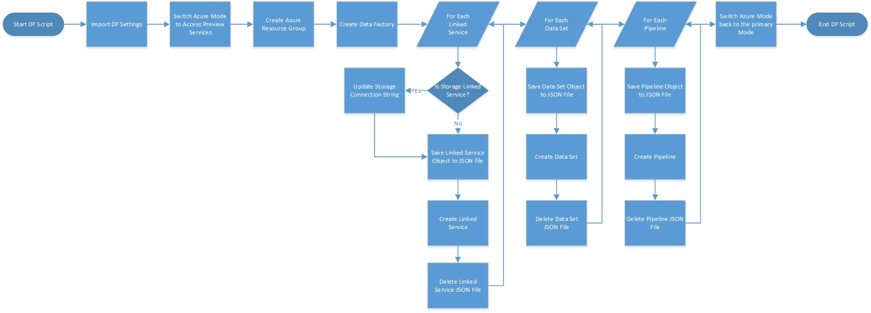
Detailed Flow – Data Factory

